Slide 1
Performance measure and evaluation

Slide 2
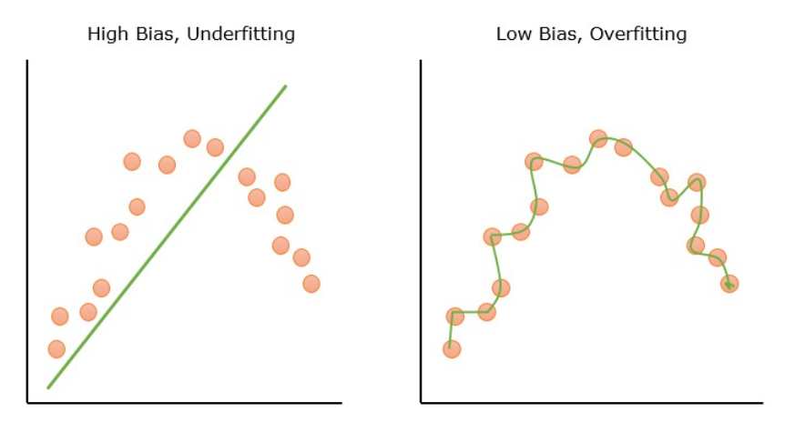
Bias
Bias refers to the error due to overly simplistic assumptions in the learning algorithm.
It occurs when a model does not capture all the complexities and patterns in the data, resulting in a difference between the average prediction of the model and the correct value.
Underfitting is a direct consequence of high bias. It happens when the model is too simple, leading to poor performance on both training and unseen data.
The model fails to learn the underlying trends in the data, making its predictions generally inaccurate.

Slide 3
Variance
It refers to the model’s sensitivity to fluctuations in the training data.
High-variance models fit the training data very closely.
Overfitting is a result of high variance. The model learns patterns that are specific to the training data, including noise and outliers.
It performs well on training data, its performance drops significantly on new, unseen data.

Slide 4
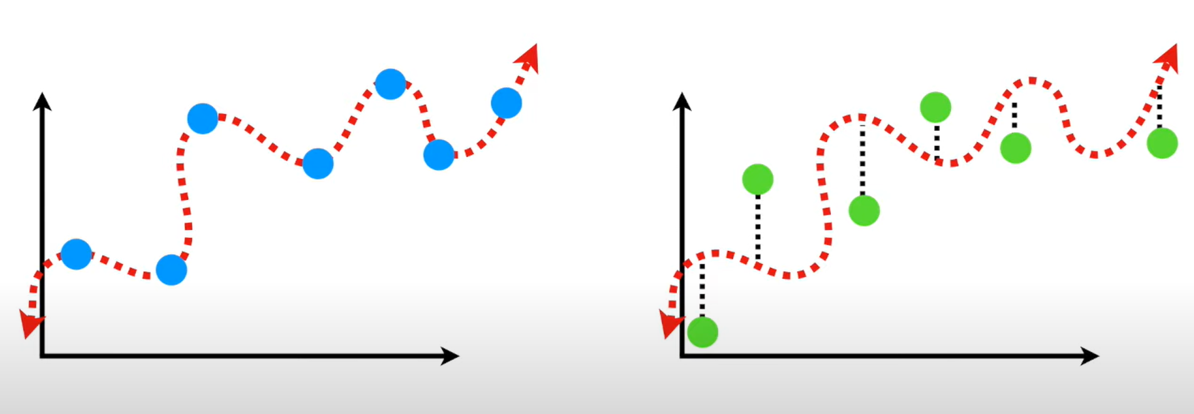
Overfitting
Blue dots – training set Green dots – testing set
Model has high variance leading to overfitting.
Performs very well on the training set but fails on the testing set (low generalization)

Slide 5
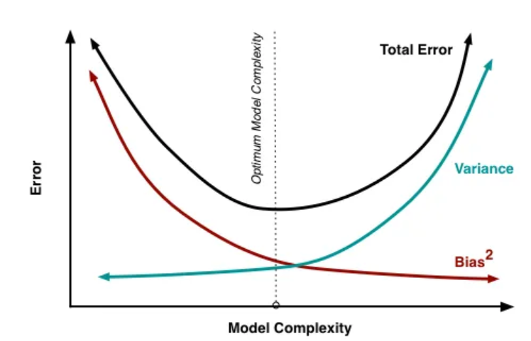
Bias Variance tradeoff
Bias and variance are inversely related; decreasing one typically increases the other. A model with high bias has low variance, and vice versa.
Total error (black curve) = Bias + Variance + Irreducible error (noise)
Initially increasing complexity reduces total error, beyond a point, more complexity makes total error rise again
Optimum Model Complexity marked by the vertical dotted line is where total error is minimized. This is the best balance between bias and variance.

Slide 6
Principle of Occam’s Razor
Occam’s Razor is a philosophical and problem-solving principle which states that "Entities should not be multiplied beyond necessity."
In other words, when faced with competing explanations for the same phenomenon, the simplest explanation that makes the fewest assumptions is usually the best.
In Machine Learning this principle can be applied to choose the simplest model that explains the data well, rather than a more complex one with extra assumptions/parameters.
This helps avoid underfitting/overfitting, enables better generalization and increases efficiency.

Slide 7
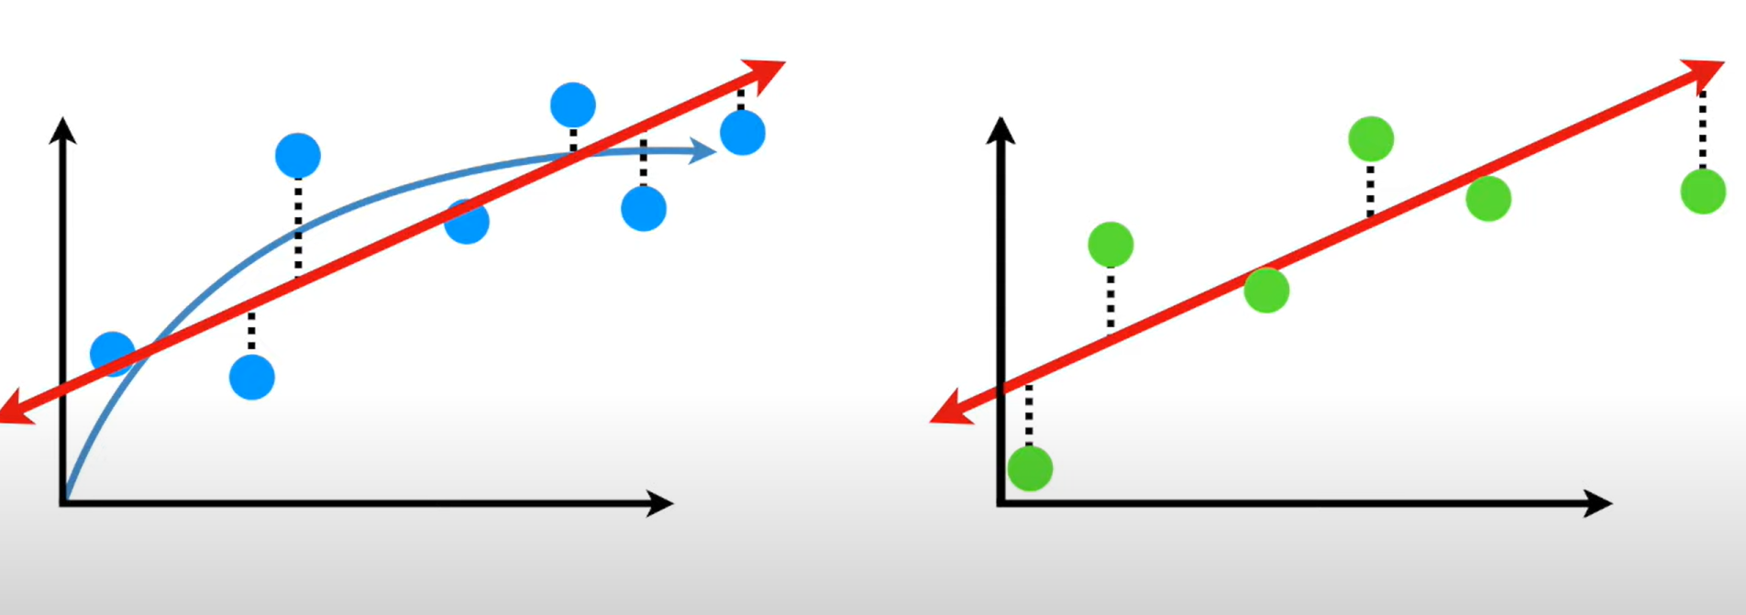
Balanced relationship
Regression line
Optimal relationship
Blue dots – training set Green dots – testing set
Regression line forms a balanced relationship performing well on both training and testing set.

Slide 8
Impact on Model Selection and Training
The complexity of a model plays a crucial role in determining its bias and variance.
Low Complexity Models (High Bias, Low Variance)
Example: Linear regression is a low-complexity model. It assumes a linear relationship between inputs and outputs, which can lead to high bias if the true relationship is more complex.
High-Complexity Models (Low Bias, High Variance)
Example: Decision trees, especially deep ones, are more complex. They can capture complex relationships in the data, but at the risk of learning noise and anomalies (overfitting).

Slide 9
Training Techniques
The way a model is trained also influences its bias and variance.
Training Data Size:
Large Datasets:
Can help reduce variance as the model has more information to learn from.
However, if the model is too simple, increasing the data size will not address its high bias.
Small Datasets:
can worsen the issue of high variance, as the model might overfit to a limited amount of data.

Slide 10
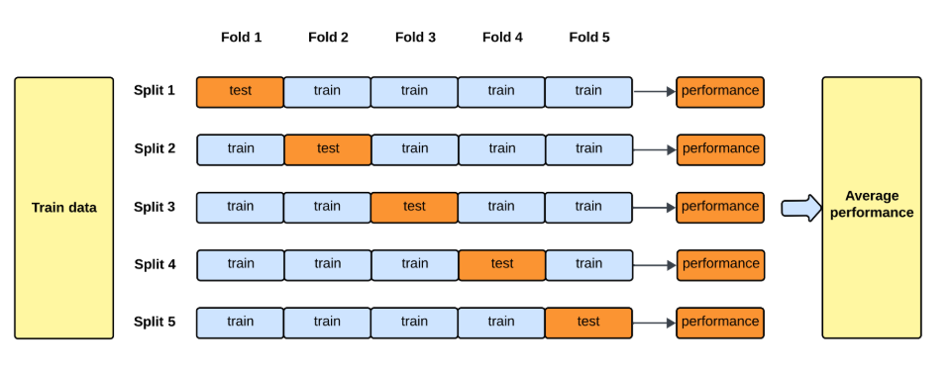
Cross validation
Dataset divided into multiple subsets and training/testing the model done on these different subsets.
It helps in understanding how the model performs on different samples of data.
Can provide insights into the model’s bias and variance.
A model with low variance will have similar performance across different folds of the data
A model with high variance might have large variations in performance.

Slide 11
Evaluation metrics
Used to measure how well a model performs.
Different metrics available based on the type of task – classification, regression, clustering
Classification
Accuracy, Precision, Recall, F1 score, ROC Curve and AUC
Regression
Mean Absolute Error (MAE), Mean Squared Error (MSE), Root Mean Squared Error (RMSE), R²
Clustering
Silhouette Score, Adjusted Rand Index (ARI), Normalized Mutual Information (NMI)

Slide 12
Classification metrics
True positive (TP) - The system correctly predicts something as positive when it really is positive.
Example: A medical test correctly identifies a sick patient as sick.
True Negative (TN) - The system correctly predicts something as negative when it really is negative.
Example: A medical test correctly identifies a healthy patient as healthy.
False Positive (FP) - The system predicts positive when in reality it is negative.
Example: A medical test says a healthy patient is sick (false alarm).
False Negative (FN) - The system predicts negative when in reality it is positive.
Example: A medical test says a sick patient is healthy (missed detection).

Slide 13
Classification metrics
Confusion Matrix
 | Actual
Predicted |  | Positive | Negative
 | Positive | TP | FP
 | Negative | FN | TN

Slide 14
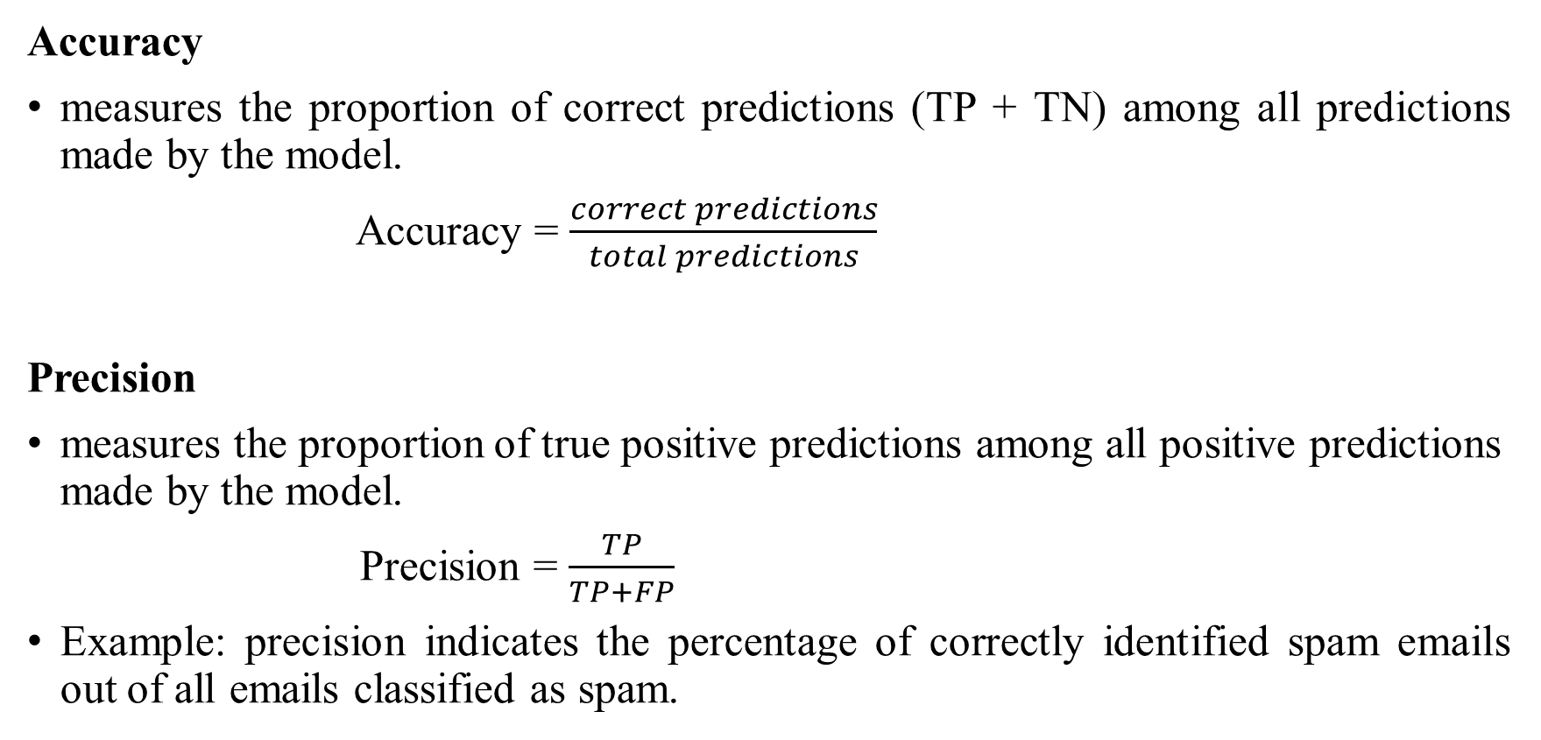
Classification metrics
Accuracy
measures the proportion of correct predictions (TP + TN) among all predictions made by the model.
Accuracy = $\frac{correct predictions}{total predictions}$
Precision
measures the proportion of true positive predictions among all positive predictions made by the model.
Precision = $\frac{TP}{TP+FP}$
Example: precision indicates the percentage of correctly identified spam emails out of all emails classified as spam.

Slide 15
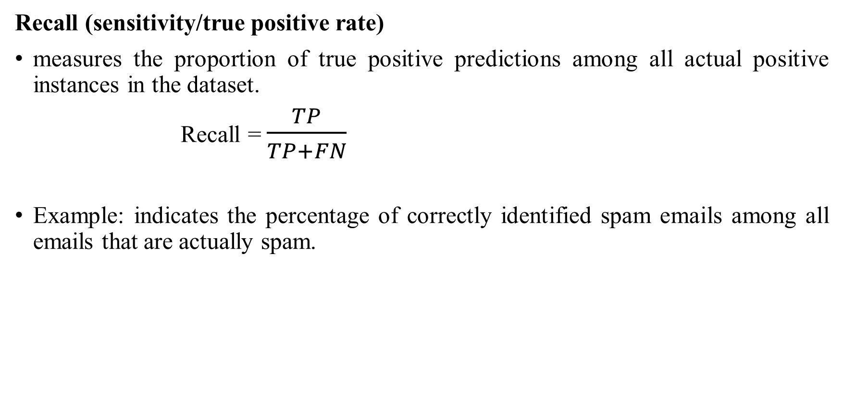
Classification metrics
Recall (sensitivity/true positive rate)
measures the proportion of true positive predictions among all actual positive instances in the dataset.
Recall = $\frac{TP}{TP+FN}$
Example: indicates the percentage of correctly identified spam emails among all emails that are actually spam.

Slide 16
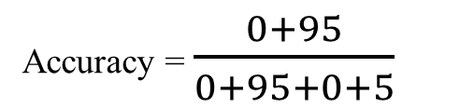
Classification metrics - Example
Dataset: 95 healthy (actual negatives) and 5 sick (actual positives)
Model prediction: everyone healthy
 | Actual
Predicted |  | Positive | Negative
 | Positive | TP = 0 | FP = 0
 | Negative | FN = 5 | TN = 95
Accuracy = $\frac{0+95}{0+95+0+5}$

Slide 17
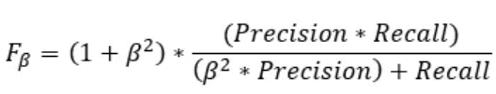
Classification metrics
F-beta score
It is a weighted harmonic mean of precision and recall, where the parameter beta controls the balance between precision and recall.
Example: Tomorrow the stock market is going to crash, here both precision and recall needs to be used as the stock market is an important entity.
Based on the importance of FP and FN, BETA can take the following values: -
Case 1 : If FP and FN both are important then, BETA = 1
Case 2 : If FP is more important than FN then, BETA = 0.5
Case 3: If FN is more important than FP then, BETA = 2

Slide 18
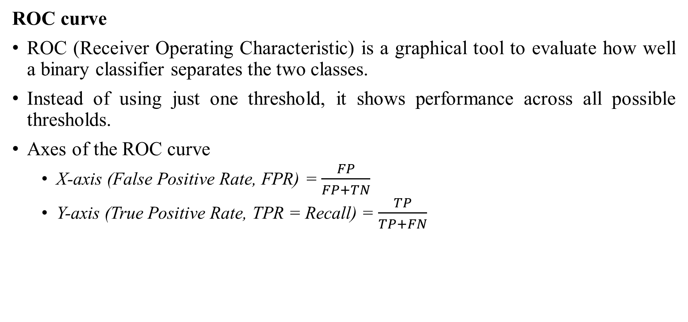
Classification metrics
ROC curve
ROC (Receiver Operating Characteristic) is a graphical tool to evaluate how well a binary classifier separates the two classes.
Instead of using just one threshold, it shows performance across all possible thresholds.
Axes of the ROC curve
X-axis (False Positive Rate, FPR) = $\frac{FP}{FP+TN}$
Y-axis (True Positive Rate, TPR = Recall) = $\frac{TP}{TP+FN}$

Slide 19
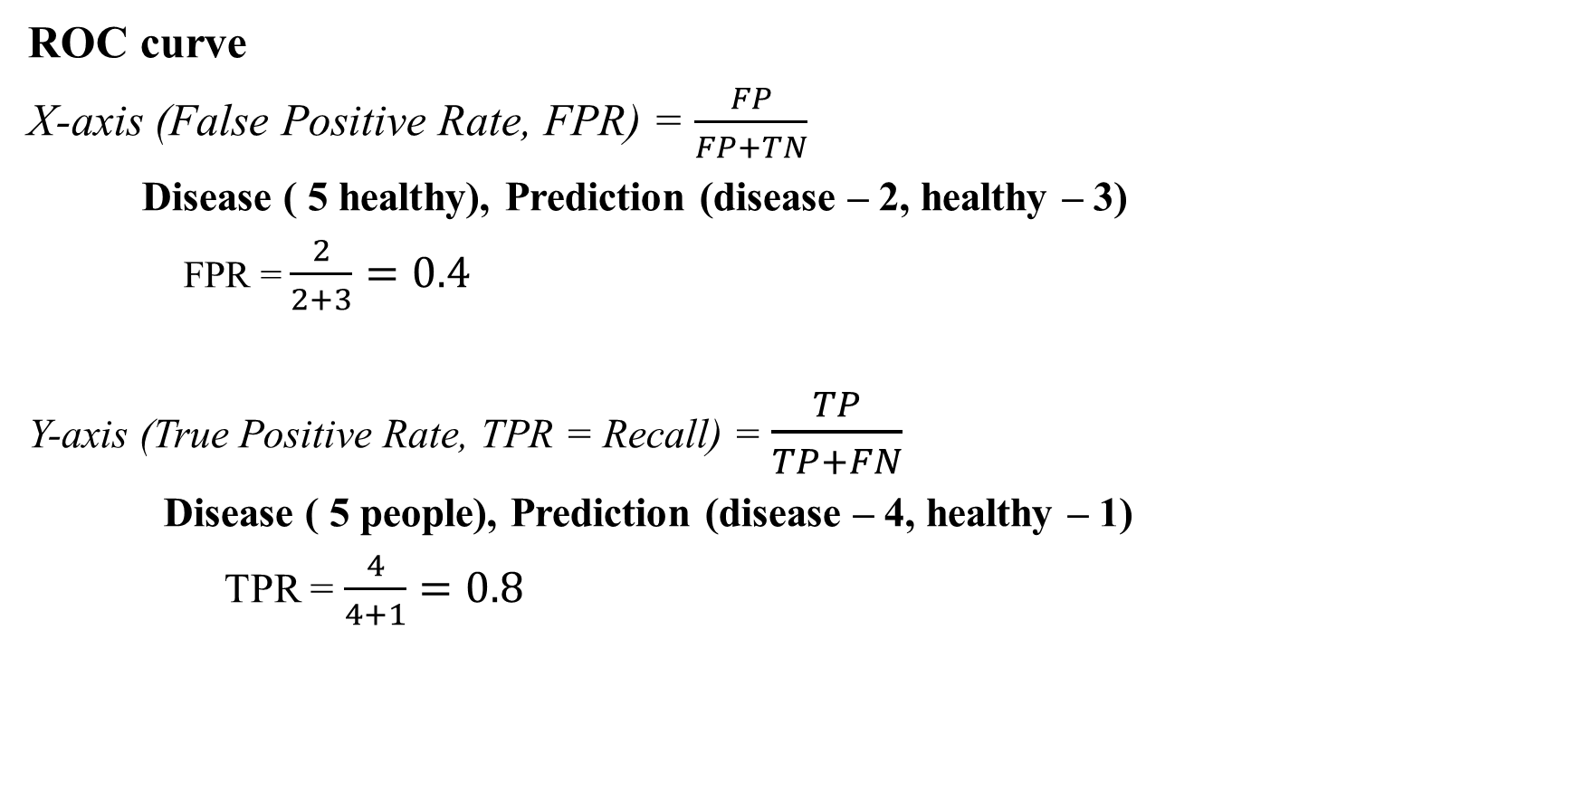
Classification metrics
ROC curve
X-axis (False Positive Rate, FPR) = $\frac{FP}{FP+TN}$
Disease ( 5 healthy), Prediction (disease – 2, healthy – 3)
FPR = $\frac{2}{2+3}=0.4$
Y-axis (True Positive Rate, TPR = Recall) = $\frac{TP}{TP+FN}$
Disease ( 5 people), Prediction (disease – 4, healthy – 1)
TPR = $\frac{4}{4+1}=0.8$

Slide 20
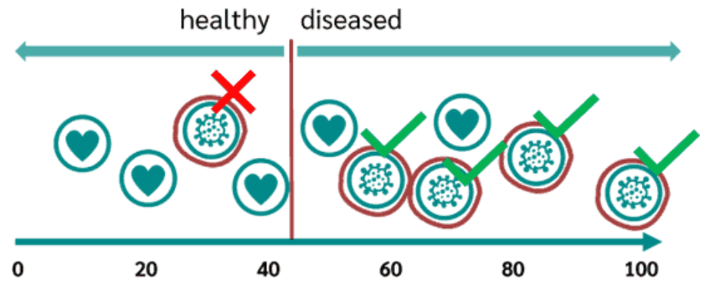
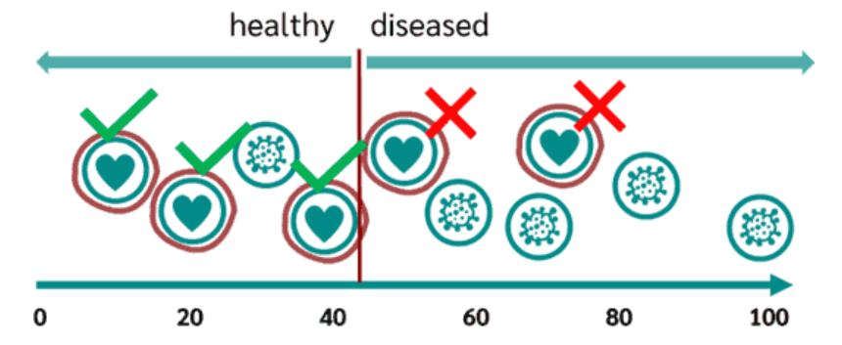
ROC Curve Example
Blood level = 45 (threshold)
Correct classification = 4
Misclassification = 1
TPR = 0.8
Correct classification = 3
Misclassification = 2
FPR = 0.4

Slide 21
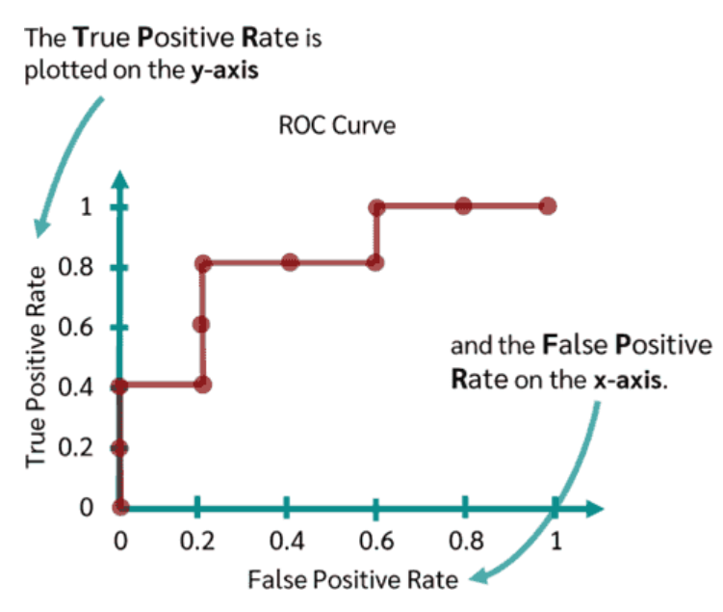
ROC Curve Example
If threshold = 0.9 → very few false positives, but may miss sick patients (low recall).
If threshold = 0.2 → catch almost all sick patients, but many false alarms.
ROC curve shows all these trade-offs in one graph.

Slide 22
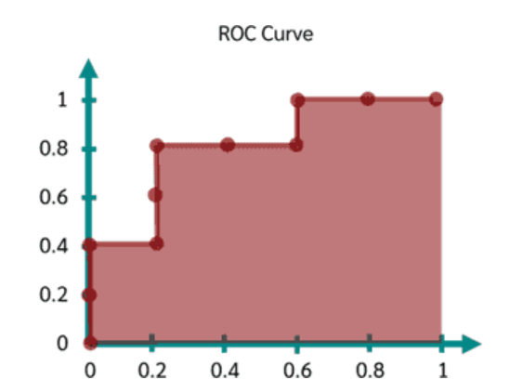
AUC (Area under the curve)
A classification model is better the higher the curve is, the larger the area under the curve, the better the classifier.
The AUC value varies between 0 and 1

Slide 23
References
https://medium.com/@sahin.samia/ml-series-8-understanding-the-bias-variance-tradeoff-in-machine-learning-1182e78e4d2d
https://www.youtube.com/watch?v=EuBBz3bI-aA&ab_channel=StatQuestwithJoshStarmer

